Slide 1
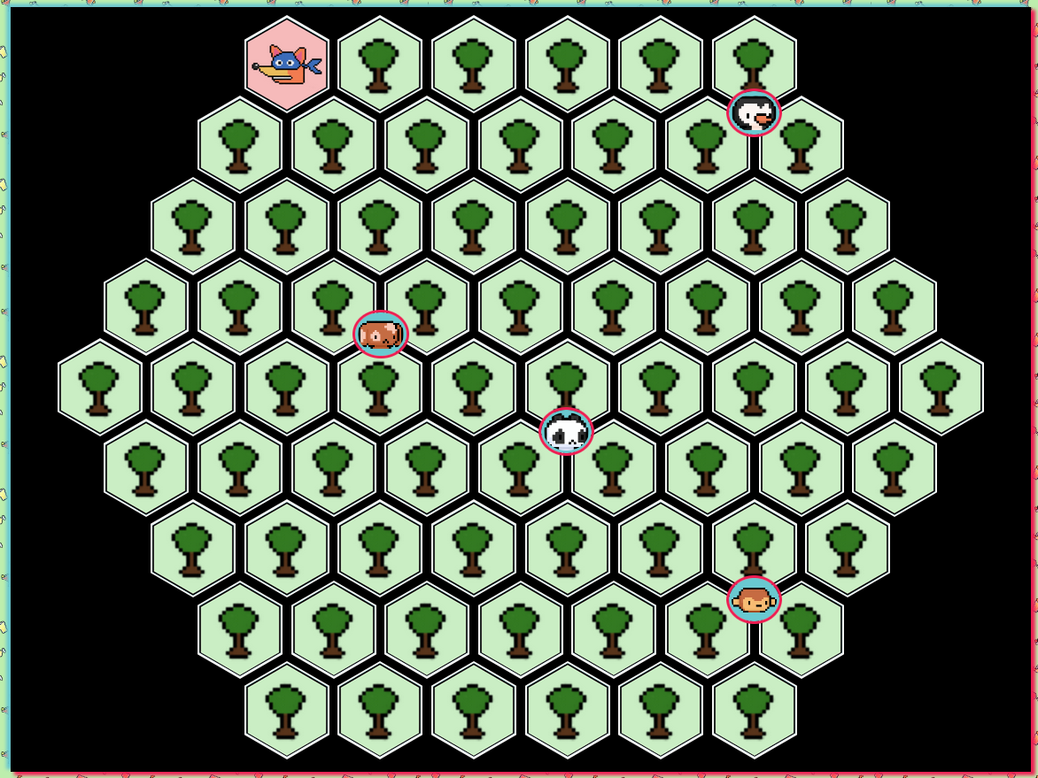
Top position
9.3%
1-?
11.3%
2-?
19.3%
3-?
21.3%
4-?
30.3%
5-?
32.3%
6-?
40.3%
7-?
42.3%
8-?
51.3%
9-?
53.3%
10-?
61.3%
11-?
63.3%
12-?
72.3%
13-?
74.3%
14-?
82.3%
15-?
84.3%
16-?
.Game #ficha_p[nro jugador] {
left : [left position]
top : [top position]
}
10.9%
20.1%
29.2%
38.3%
47.6%
56.7%
65.9%
75%
84.2%
Left position
15.4%
24.6%
33.8%
43%
52.2%
61.2%
70.4%
79.6%

